Slide 2
The Giver vocabulary
Chapters 3-5

Slide 3
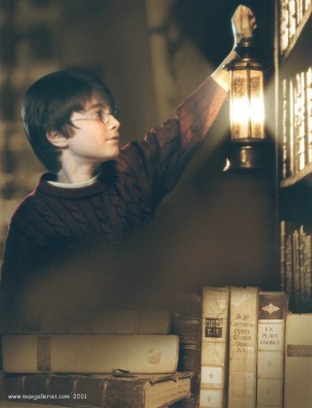
Forbidden
(adj.) banned, not allowed
Harry and Ron frequented the “forbidden” section of the library.

Slide 4
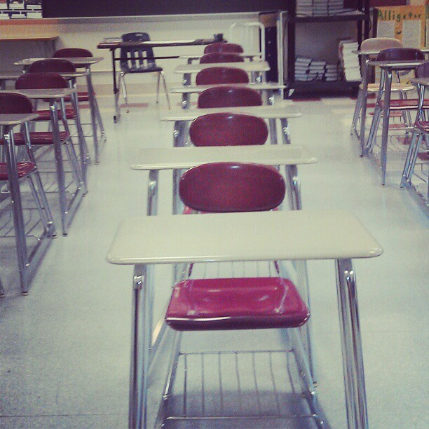
Nondescript
(adj.) lacking distinctive characteristics or qualities
The classroom was very nondescript – it lacked posters, colors, and bulletin boards.

Slide 5
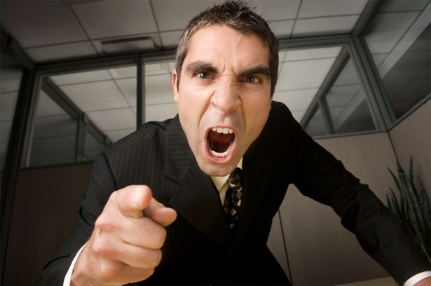
Chastise
(v.) rebuke or reprimand seriously
The boy was constantly chastised by his teacher for talking out of turn.

Slide 6
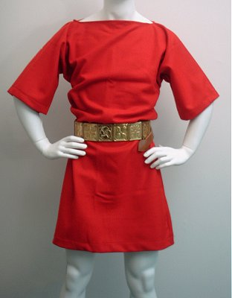
Tunic
A loose garment, typically sleeveless and reaching to the wearer's knees, as worn in ancient Greece and Rome.
The girl wore a tunic shirt with black leggings.

Slide 7
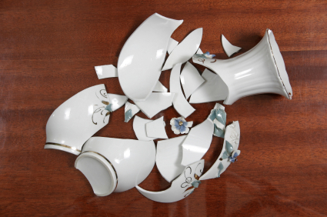
Fragment
(n.) A small part broken or separated from something.
My brother dropped the vase and it broke into many fragments.

Slide 8
Perspiring
(v.) Give out sweat through the pores of the skin as the result of heat, physical exertion, or stress.
The boys were all perspiring after gym class.

Slide 9
The Giver vocabulary
Chapters 6-7

Slide 10
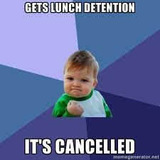
Reprieve
(n.) A cancellation or postponement of a punishment.
She received a reprieve from her Saturday detention because of snow.

Slide 11
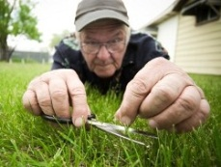
meticulously
(adj.) Showing great attention to detail; very careful and precise.
Woodworking can be a very meticulous trade – one which requires great skill and patience.

Slide 12
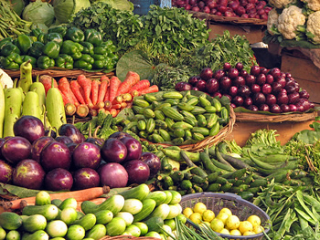
nourishment
(n.) The substances necessary for growth, health, and good condition.
Proper nourishment is important during PSSAs to obtain a proficient score.

Slide 13
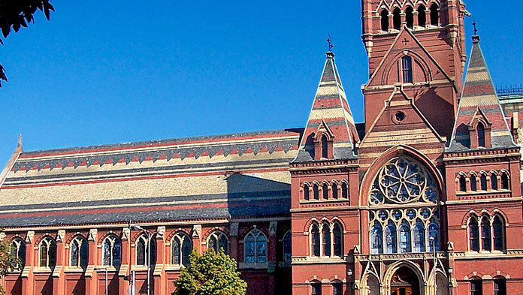
prestige
(n.) Respect and admiration felt for someone or something on the basis of their quality.
The girl was looking at many prestigious schools so she could get an excellent education.

Slide 14
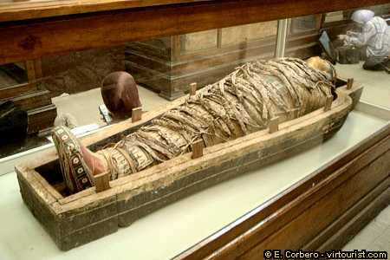
acquisition
(n.) An asset or object bought or obtained, typically by a library or museum.
The Reading Museum received its newest acquisition – a mummy.

Slide 15
The Giver Vocabulary
Chapters 8 & 9

Slide 16

Crescendo
(n.) A gradual increase in loudness.
The crescendo in the score of “Wicked” symbolized the start of the musical.

Slide 17
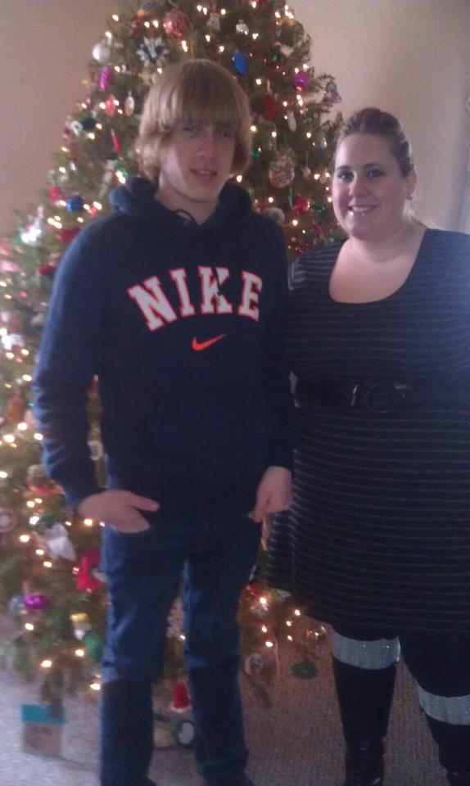
Kinship
(n.) Blood relationship.
A sharing of characteristics or origins.
My younger brother, Jack, and I have a kinship.

Slide 18
Prohibited
(v.) Formally forbid (something) by law, rule, or other authority.
Students are prohibited from chewing gum in class.

Slide 19
Excruciating
(adj.) incredibly painful
The girl was in excruciating pain when she broke her arm in the soccer game.

Slide 20
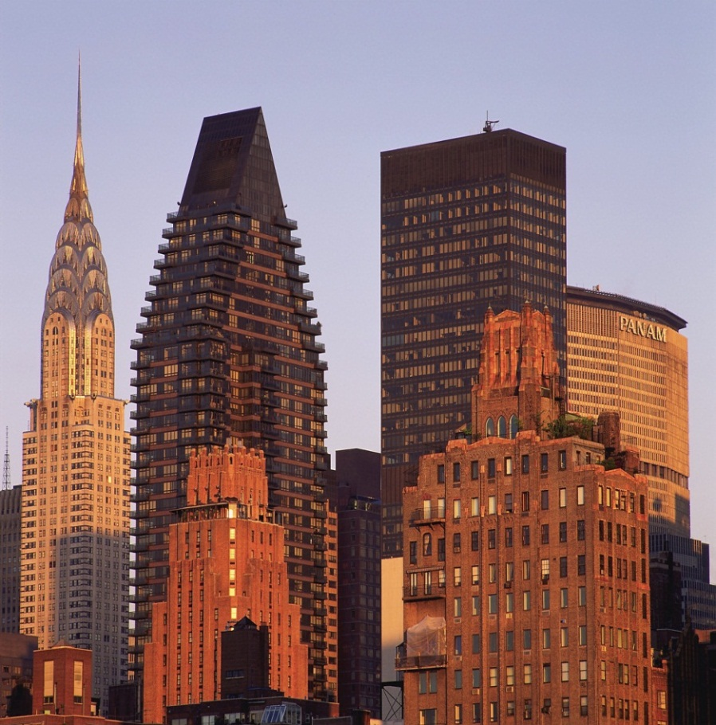
Diminished
(adj.) Made smaller or less.
The city diminished below her as the plane flew through the sky.

Slide 21
The Giver Vocabulary
Chapters 10-11

Slide 22
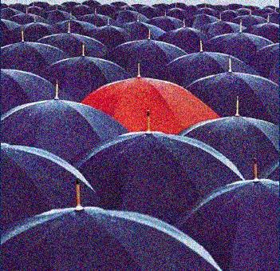
Conspicuous
Adj. Standing out so as to be clearly visible.
The girl who didn’t wear her uniform to school was conspicuous during the concert.

Slide 23
Tentatively
Adv. Not fully worked out, concluded, or agreed on; provisional
We made tentative plans to meet at the park next weekend.

Slide 24
Frigid
Adj. Very cold in temperature
It was so frigid outside that the boy needed to wear his winter coat, a hat, a scarf, and mittens.

Slide 25
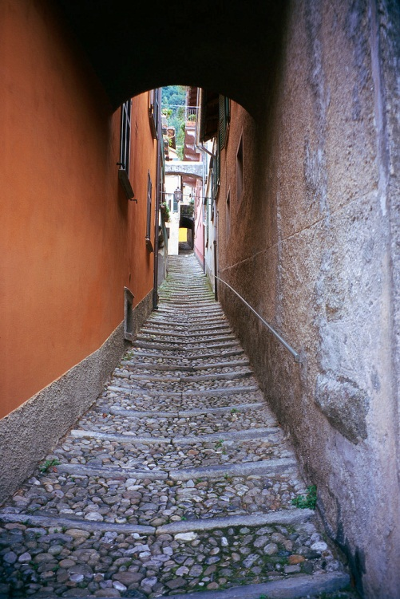
Incline
N. An sloped surface, esp. on a road, path, or railway.
Climbing the incline of the mountain provided many sights to the tourists.

Slide 26
Obsolete
Adj. No longer produced or used; out of date.
The mother tried to convince her daughter to wear an obsolete sweater to the dance.

Slide 27
Conveyance
N. The action or process of transporting someone or something from one place to another.
During the conveyance, the baby fell asleep in her car seat.

Slide 28
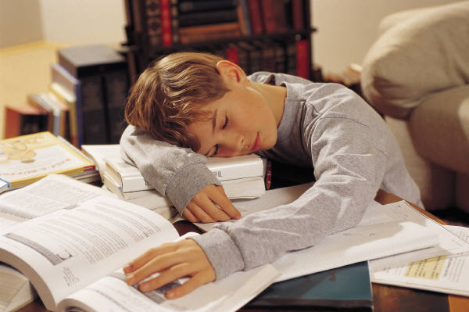
Weary
Adj. Feeling or showing tiredness, esp. as a result of excessive exertion or lack of sleep.
The boy was weary after spending the entire day studying for tests.

Slide 29
The Giver vocabulary
Chapters 12-13

Slide 30
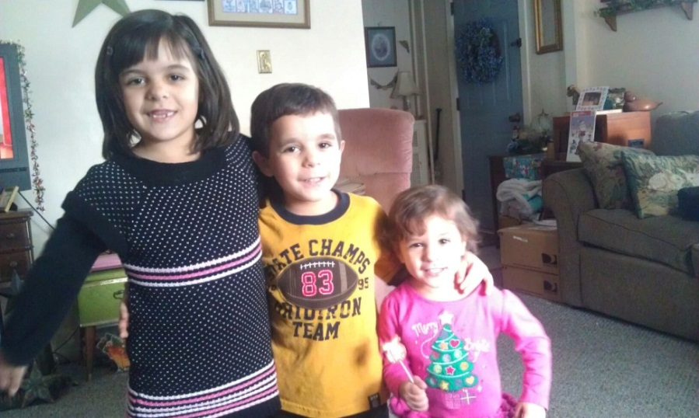
Genetic
Adj. Of or relating to genes or heredity.
It was obvious they were siblings because they had the same genetic traits – brown hair and big brown eyes.

Slide 31
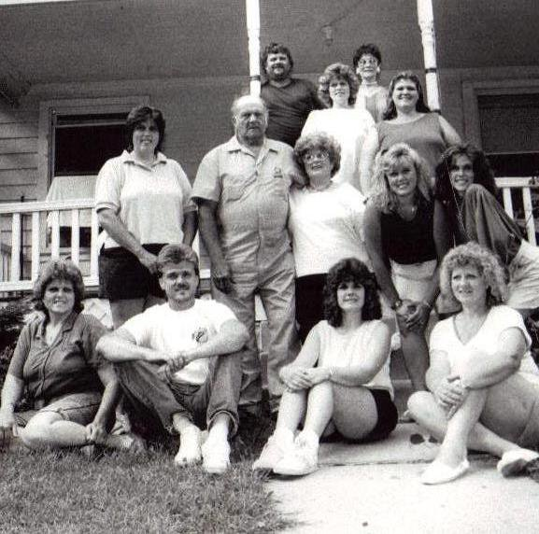
Hueless
Adj. of something totally lacking in saturation and therefore having no hue.
The photograph of my aunts and uncles from years ago was completely hueless.

Slide 32
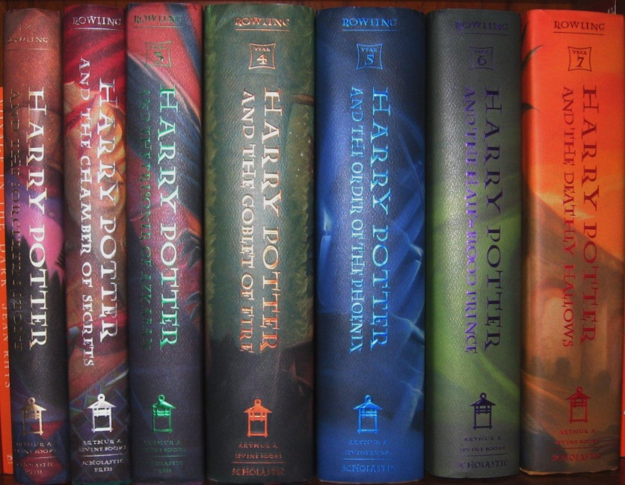
Volumes
N. A book forming part of a work or series.
The volumes of the Harry Potter series lined the shelves of the library.

Slide 33
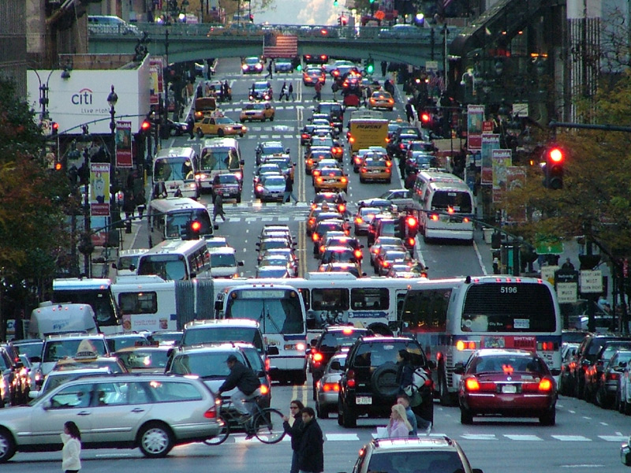
Chaos
N. Complete disorder and confusion.
The chaos of New York traffic makes even the best driver worried.

Slide 34
The Giver Vocabulary
Chapters 14-15

Slide 35
Ointment
N. A smooth oily preparation that is rubbed on the skin for medicinal purposes or as a cosmetic.
The boy applied ointment to his poison ivy.

Slide 36
Injection
N. A shot or an item placed into something else.
As children, we received Chicken Pox injections.

Slide 37
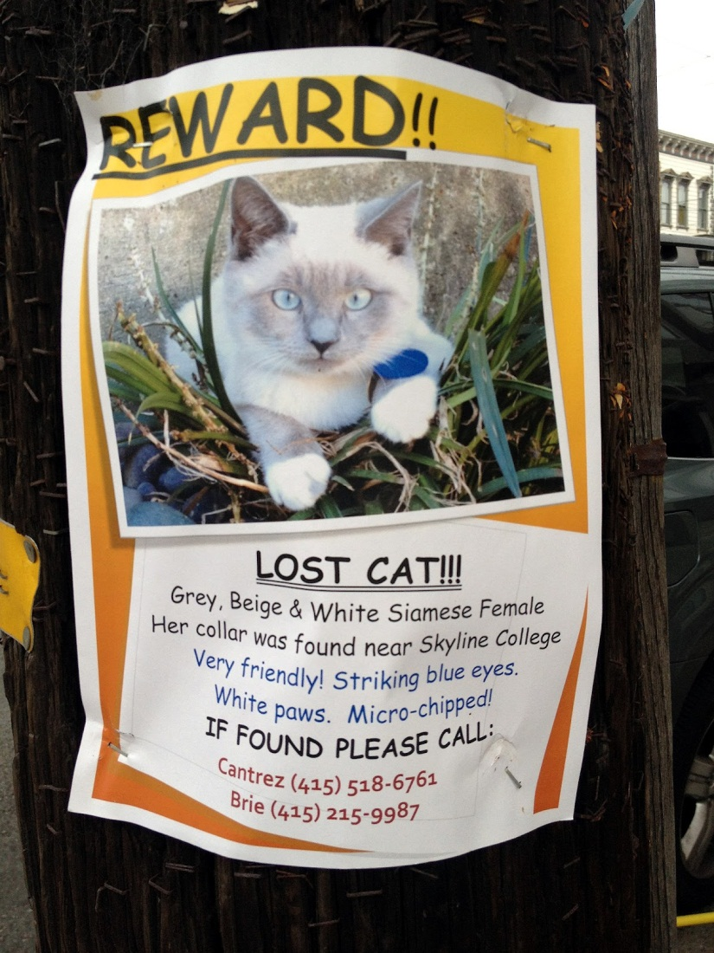
Deliverance
N. The action of being rescued or set free:
I was grateful for my cats safe deliverance so I payed the person that returned her a large reward.

Slide 38
Unendurable
Adj. incapable of being put up with
Sharon had unendurable sore throats so she needed her tonsils taken out.

Slide 39
Petitioned
N. A formal written document requesting a right or benefit from a person or group in authority.
We petitioned the principal to allow to chew gum in school.

Slide 40
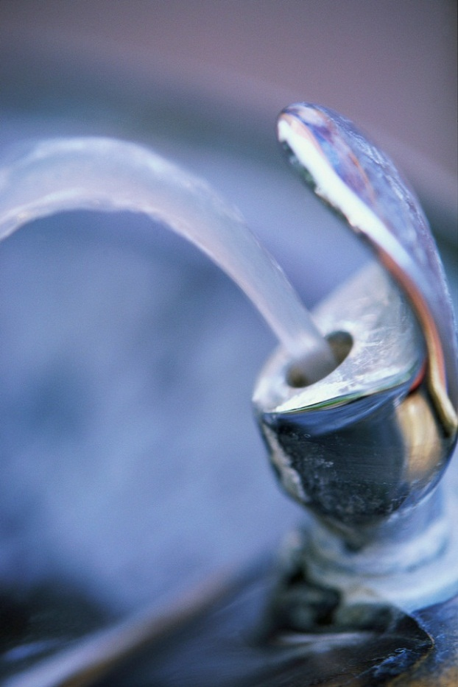
Parched
Adj. dried out by heat or excessive exposure to sunlight
When parched, a student may say, “Miss Diem, may I get a drink?”

Slide 41
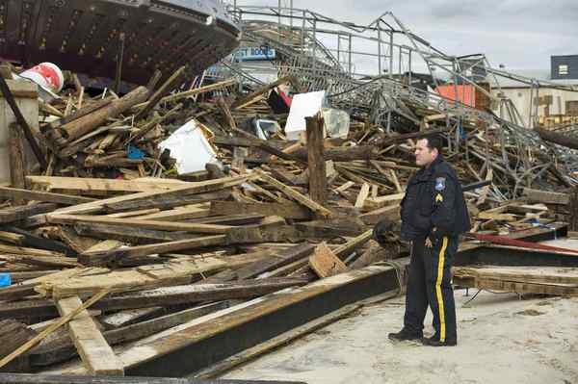
Carnage
N. Massive slaughter, as in war; a massacre.
The Black Plague caused massive carnage in Europe.

Slide 42
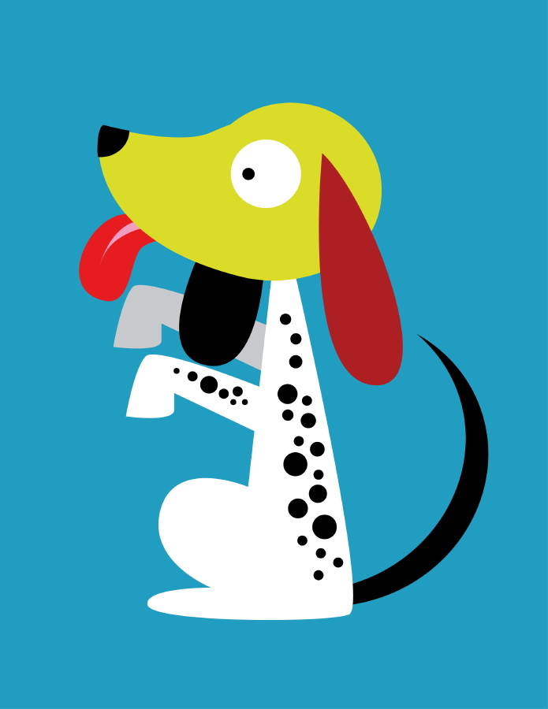
Imploring
V. Begging
The dog was imploring his owner for a piece of dinner.

Slide 43
The Giver Vocabulary
Chapters 19-20

Slide 44
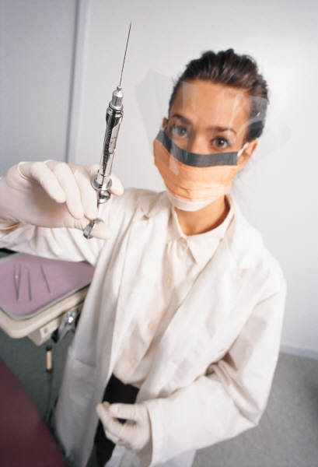
Syringe
N. an instrument, such as a hypodermic syringe or a rubber ball with a slender nozzle
The doctor gave me a shot with a syringe.

Slide 45
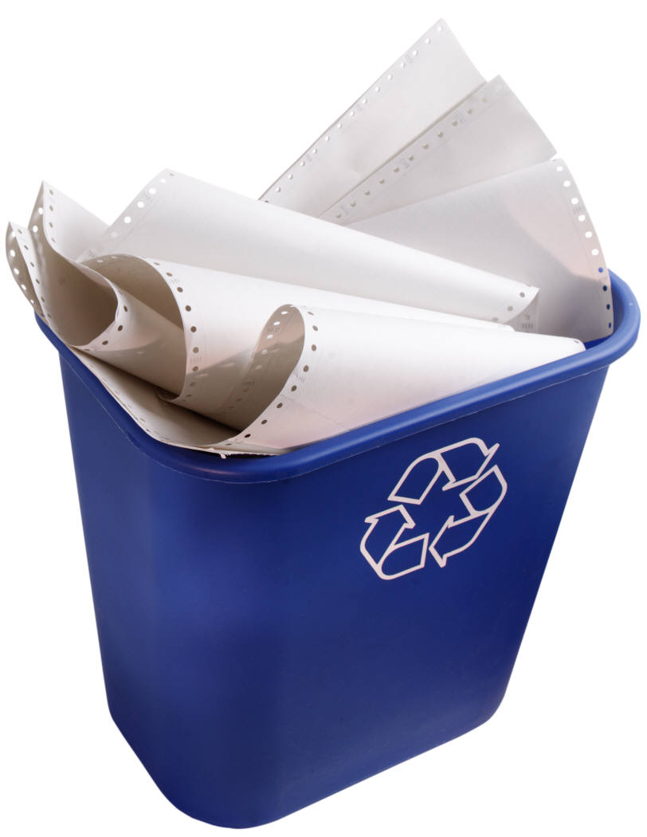
Receptacle
N. an object that holds something; container
Always put your paper, glass, and plastic in the proper receptacle.

Slide 46

Empowered
V. To equip or supply with an ability; enable
The boss was empowered to make the decision about the deal with the rival company.

Slide 47
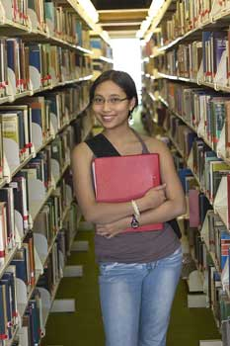
Remarkable
Adj. Worthy of notice.
Tien was a remarkable girl – she could count in 15 different languages!

Slide 48
The Giver vocabulary
Chapters 21-end

Slide 49
Stealthily
Adj. Marked by or acting with quiet, caution, and secrecy
Ostriches try to be stealth and hide in the ground – it doesn’t work though!

Slide 50
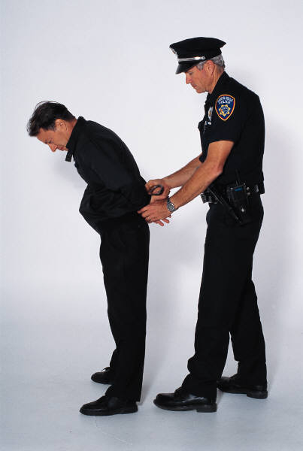
Fugitive
Adj. Running away or fleeing, as from the law.
The man was a fugitive – he had stolen from six different stores!

Slide 51
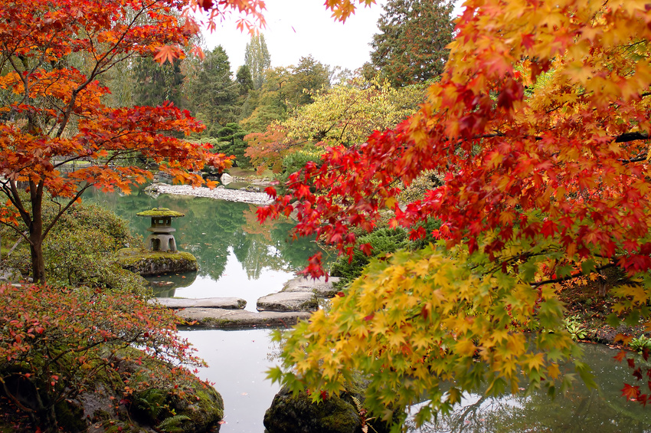
Foliage
N. Plant leaves, especially tree leaves, considered as a group.
The foliage in fall is absolutely gorgeous.

Slide 52
Habitation
N. A natural environment or locality
Zoos work hard to reproduce the habitations of the animals.

Slide 53
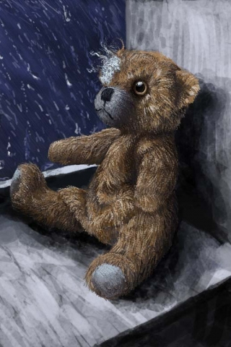
Incision
N. A cut into a body tissue or organ, especially one made during surgery
The incision from her surgery healed well – there was no scar!

